Slide 1
DEVELOPMENT
OF A PLAIN INPUT MATHEMATICAL COMPUTING FRAMEWORK.
PRESENTED BY:
JIBOYE Oluwagbemiro Olaoluwa
CSC/2005/089
AUGUST, 2010.

Slide 2
OUTLINE
Problem Definition
Project Justification
Aim and Objectives
Methodology
System Design
Literature Review
Conclusion.

Slide 3
PROBLEM DEFINITION
The problem is to develop an easy to use combination of a mathematical expression parser and its interaction interface which will allow users to enter mathematical expressions in a form that is close to plain mathematical language, and also evaluate them.

Slide 4
PROJECT JUSTIFICATION
A great challenge that users face when interacting with mathematical computing software is that many of them do not take input in plain mathematical language.
For example, 2x³+3x²-5x+1 is written in the popular Matrix Laboratory software as
[2 3 -5 1]. A new user would however, input it in plain mathematical form and this has caused an under-utilization of this software.

Slide 5
AIM AND OBJECTIVES
The aim to develop a mathematical framework to solve diverse mathematical problems, using plain mathematical expressions as input.
The objectives are to:
design a system of mathematical parsers, each one having a specific target mathematical problem which it will solve.
design a mathematical interface through which the user will interact with the parsers.
implement the two designs above.

Slide 6
METHODOLOGY
The Unified Modeling Language for the design
The Java2 SE (Standard Edition) to implement the design

Slide 7
LITERATURE REVIEW
The development of MathParser (Murray, 2009), who under-studied previous work done in the field by Graham,1975.
The MathWorks.Inc,1984 developed the all-popular MatLab software for easing solutions to mathematical problems.

Slide 8
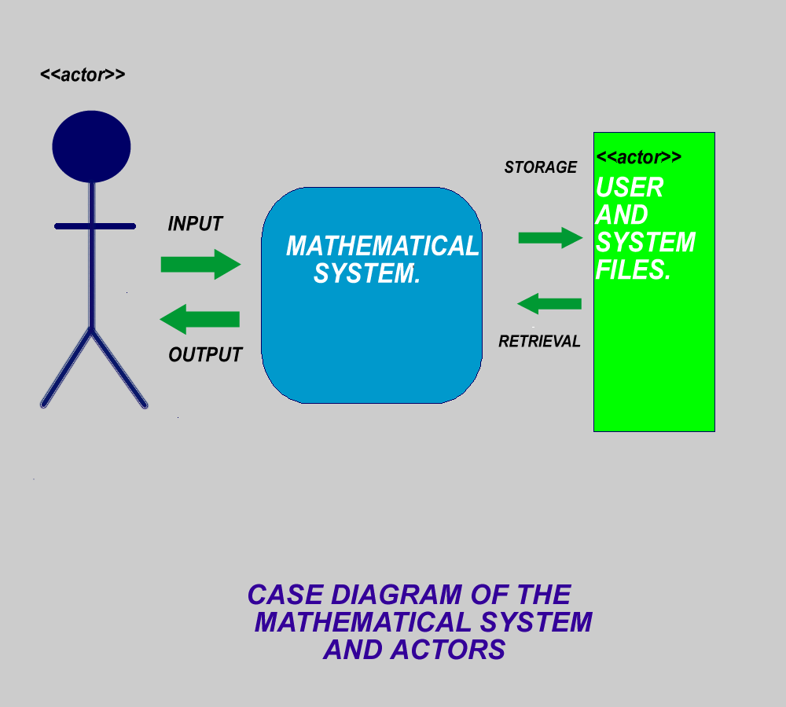
SYSTEM DESIGN

Slide 9
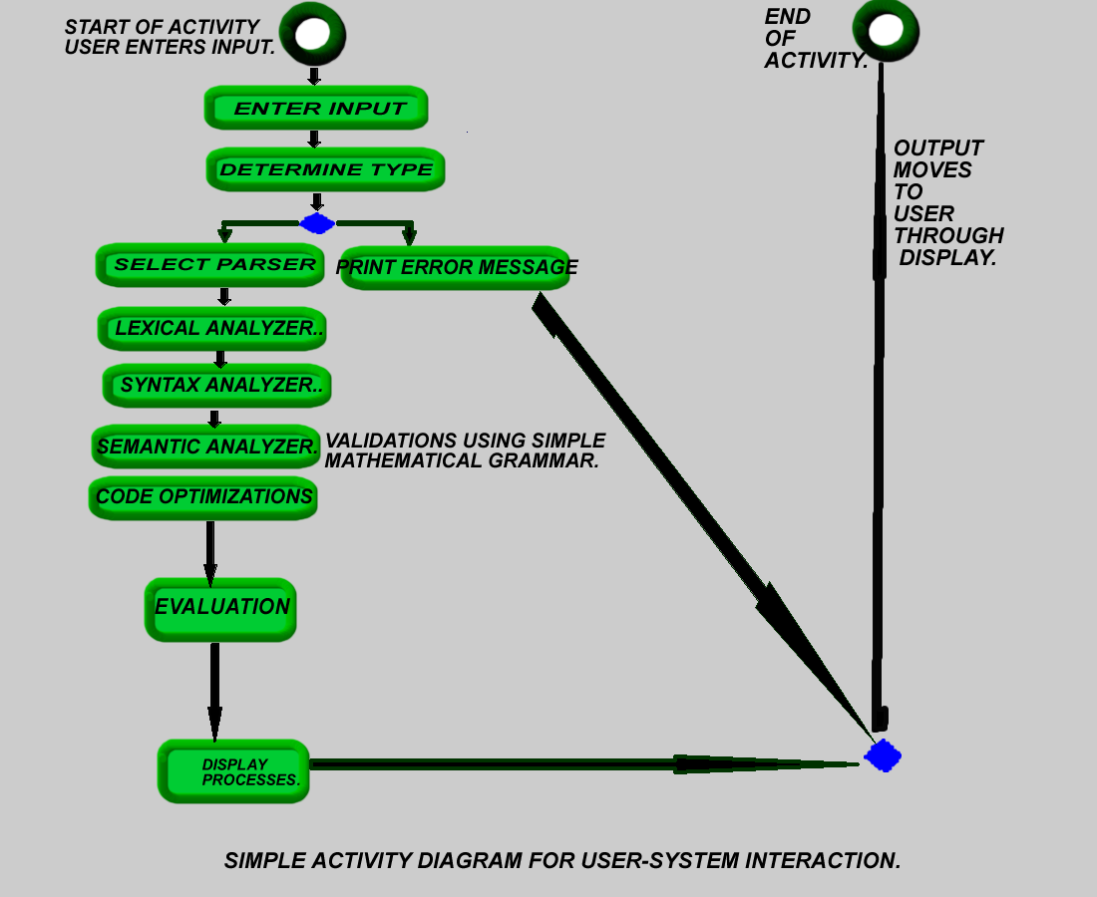

Slide 10
CONCLUSION
At the end of this project, many users will be able to interact freely with this math software and solve mathematical problems with minimal need to learn the software usage syntax from scratch.

Slide 11
THANKS FOR LISTENING!!

